Slide 1
Introduction to DevOps
Sonika Rathi
Assistant Professor
BITS Pilani

Slide 2
Agenda
DevOps – People
DevOps Team Structure
Team Coordination

Slide 3
Team Structure
Team Size
The size of the team should be relatively small
Amazon has a “two pizza rule”
That is, no team should be larger than can be fed from two pizzas
The advantages of small teams are
They can make decisions quickly
It is easier for individuals to express an opinion
It is easier for individuals to express an idea in front of a small group than in front of a large one
The disadvantage
Some tasks are larger than can be accomplished by a small number of individuals
Task has to be broken up into smaller pieces
A small team, by necessity, works on a small amount of code

Slide 4
Team Structure
Team Roles
We will study roles in the team from Scott Ambler’s description of roles in an agile team
Team lead :
This role you can relate to “Scrum Master” of SCRUM TEAM.
Also you can relate to Project Lead
Is responsible:
For facilitating the team
Obtaining resources for it
And protecting it from problems
This role encompasses the soft skills of project management but not the technical ones such as planning and scheduling, activities which are better left to the team as a whole.
Team member
This role, sometimes referred to as developer or programmer
Is responsible for the creation and delivery of a system
This includes modeling, programming, testing, and release activities, as well as others

Slide 5
Team Structure
Additional roles
Service owner
Reliability engineer
Gatekeeper
And DevOps engineer

Slide 6
Team Structure
Service Owner
This role on the team responsible for outside coordination
The service owner participates:
System-wide requirements activities
Prioritizes work items for the team
And provides information both from the clients of the team’s service and about services provided to the team.
The requirements gathering and release planning activities for the next iteration can occur in parallel with the conception phase of the current iteration
The service owner maintains and communicates the vision for the service
That is, the vision involves the architecture of the overall system and the team’s role in that architecture

Slide 7
Team Structure
Reliability Engineer
Reliability engineer monitors the service in the time period immediately subsequent to the deployment
Second, the reliability engineer is the point of contact for problems with the service during its execution
Google calls this role “Site Reliability Engineer.”
Once a problem occurs, the reliability engineer performs short-term analysis to diagnose, mitigate, and repair the problem
In any case, the reliability engineer has to be excellent at troubleshooting and diagnosis
The reliability engineer should discover or work with the team to discover the root cause of a problem
Increasingly, reliability engineers need to be competent developers, as they need to write high-quality programs to automate the repetitive part of the diagnosis, mitigation, and repair

Slide 8
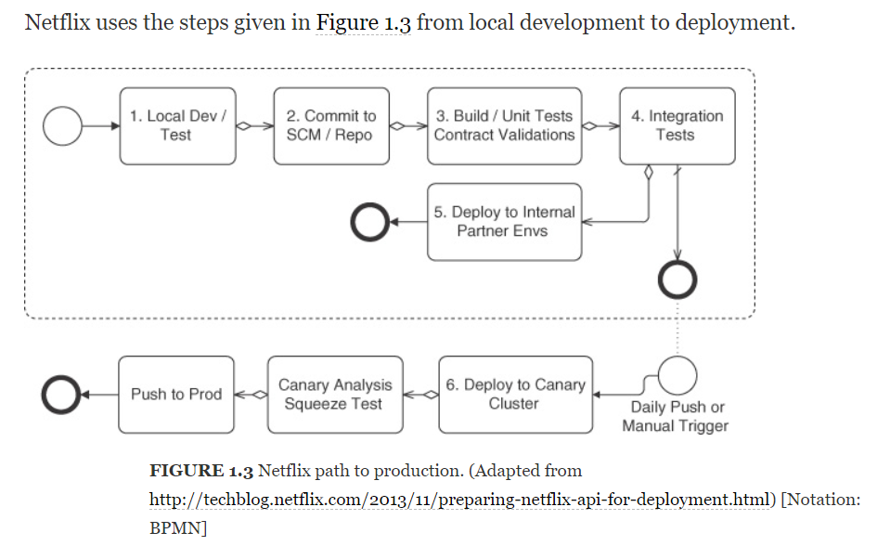
Team Structure
Gatekeeper

Slide 9
Team Structure
DevOps Engineer
The DevOps engineer role is responsible for the care and feeding of the various tools used in the DevOps tool chain
The DevOps engineer’s role, as are the tailoring of the tool for the development team and monitoring
The DevOps engineering role is inherent in automating the development and deployment pipeline
DevOps engineer also deals with configuration managements tools which are like Puppet, Ansible and Chef etc.
These configuration management solutions are applied to the source code for the service

Slide 10
Team Coordination
Forms of Coordination
One goal of DevOps is to minimize coordination in order to reduce the time to market
Two of the reasons to coordinate are, first, so that the pieces developed by the various teams will work together and, second, to avoid duplication of effort
Forms of Coordination
Direct—the individuals coordinating know each other (e.g., team members)
Indirect—the coordination mechanism is aimed at an audience known only by its characterization (e.g. Operators)
Persistent—the coordination artifacts are available after the moment of the coordination (e.g., documents, e-mail, bulletin boards)
Ephemeral—the coordination, per se, produces no artifacts (e.g., face to face meetings, conversations, telephone/video conferencing)
Synchronous—individuals are coordinating in real time, (e.g., face to face)
Asynchronous—individuals are not coordinating in real time (e.g., documents, e-mail)

Slide 11
Team Coordination
Team coordination mechanisms
Team coordination mechanisms are of two types
Human Processes and
Automated Processes
The DevOps human processes are adopted from agile processes and are designed for high-bandwidth coordination with limited persistence
Examples: Stand-up meetings
Automated team coordination mechanisms are designed to protect team members from interference of their and others’ activities:
To automate repetitive tasks (continuous integration and deployment),
And to speed up error detection and reporting (automated unit, integration, acceptance, and live production tests)

Slide 12
Team Coordination
Cross-team Coordination
Coordination must occur with customers, stakeholders, other development teams, and operations. Therefore, DevOps processes attempt to minimize this coordination as much as possible
There are three types of cross-team coordination:
Upstream Coordination [with stakeholders and customers]
Downstream Coordination [with operations]
And Cross-Stream Coordination [with other development teams]
There are two reasons for a development team to coordinate with other development teams
To ensure that the code developed by one team works well with the code developed by another
And to avoid duplication of effort

Slide 13
Thank You!
In our next session:

